Slide 1
Subscribing to Multiple Observables

Slide 2
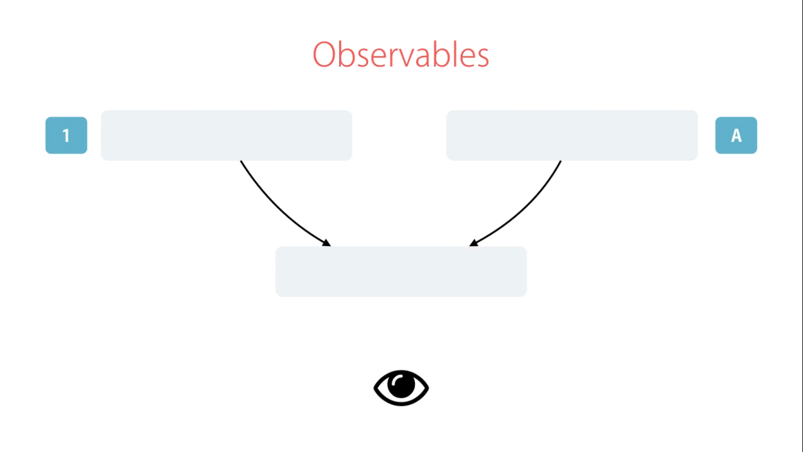

Slide 3
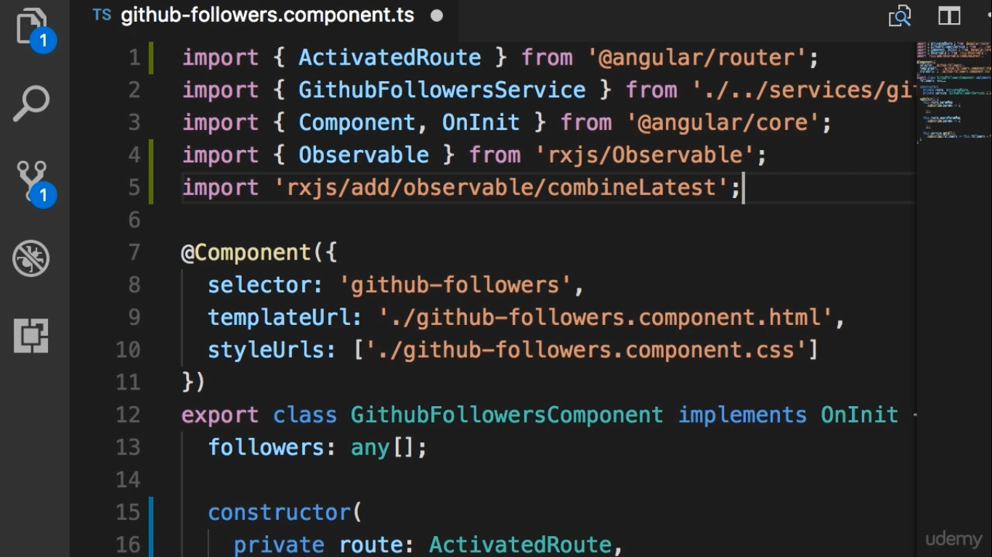
Factory Method

Slide 4
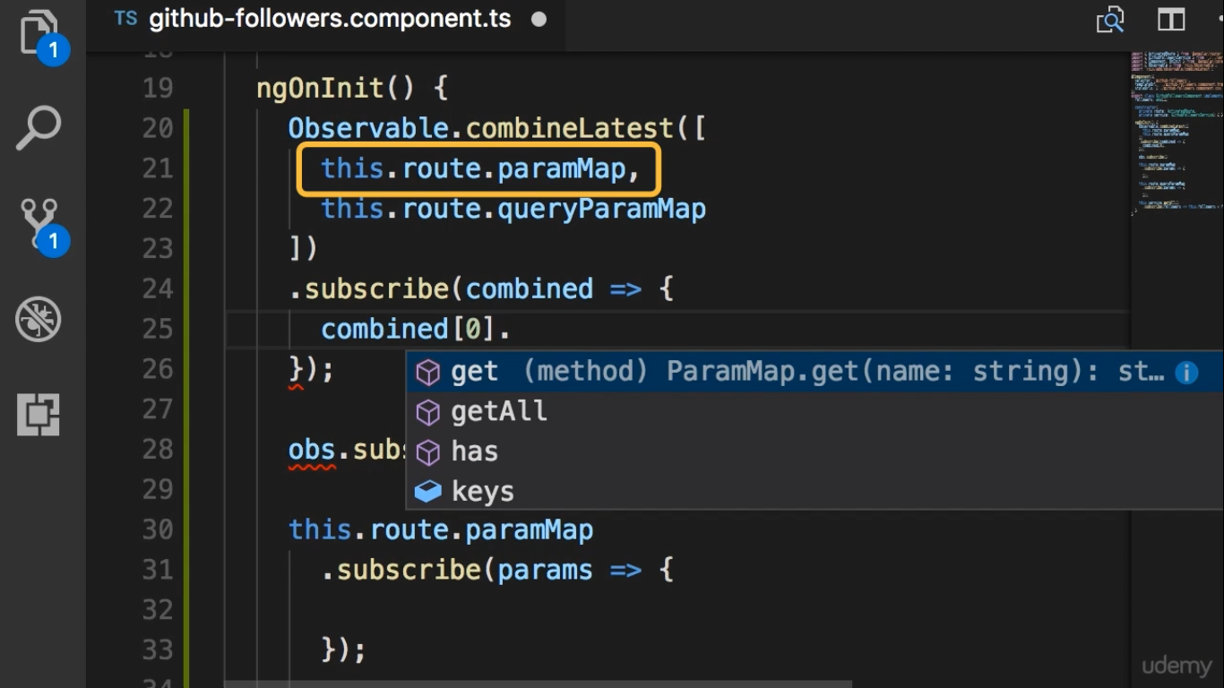

Slide 5
